Slide 1

Logistic Regression (Math)
Presented by:
Elizer Ponio Jr.
Department of Computer Science
College of Computing and Information Technologies

Slide 2
Outline
Math Behind Logistic Regression
Maximum Likelihood

Slide 3
Obese
Not Obese
1
2
3
4
5
In logistic regression, our goal is to draw the best fitting S-curved line to the data

Slide 4
In logistic regression, our goal is to draw the best fitting S-curved line to the data
Obese
Not Obese
1
2
3
4
5

Slide 5

To do this, we need to transform the y-axis from a probability of obesity scale…
Obese
Not Obese
1
2
3
4
5

Slide 6

3
2
To a log(odds of obesity) scale.
1
0
-1
-2
-3

Slide 7
3
Then we can draw a best fitting line on the graph
2
1
0
-1
-2
-3

Slide 8
+ Infinity
3
The only problem is that this transformation pushes the raw data to positive infinity and negative infinity
2
1
0
-1
-2
-3
- Infinity

Slide 9
+ Infinity
3
And this means that the residuals are also equal to positive and negative infinity
2
1
0
-1
-2
-3
- Infinity

Slide 10
+ Infinity
3
And this means that we cannot use least squares to get the best fitting line
2
1
0
-1
-2
-3
- Infinity

Slide 11
+ Infinity
3
Instead, we use maximum likelihood.
2
1
0
-1
-2
-3
- Infinity

Slide 12
+ Infinity
3
First, we project the raw data points to the candidate line
2
1
0
-1
-2
-3
- Infinity

Slide 13
+ Infinity
3
To get the candidate log (odds) value for each data point
2
1
0
-1
-2
-3
- Infinity

Slide 14

+ Infinity
3
For example, the log (odds) of this data point is 2.1
2
1
0
-1
-2
-3
- Infinity

Slide 15
+ Infinity
3
And the log(odds) of this data point is -1.4
2
1
0
-1
-2
-3
- Infinity

Slide 16
+ Infinity
3
Then we transform the candidate log (odds) to candidate probabilities using this formula
2
1
0
-1
-2
-3
- Infinity

Slide 17
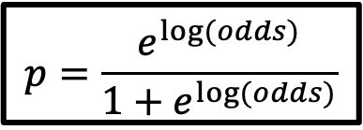
+ Infinity
1
3
2
1
0
-1
0
-2
-3
1
2
3
4
5
- Infinity
Then we transform the candidate log (odds) to candidate probabilities using this formula:
$$p=\frac{e^{\log{(odds)}}}{1+e^{\log{(odds)}}}$$

Slide 18
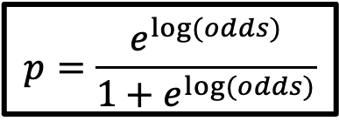
+ Infinity
3
Now, let us see how we use this equation:
in action!
2
1
$$p=\frac{e^{\log{(odds)}}}{1+e^{\log{(odds)}}}$$
0
-1
-2
-3
- Infinity

Slide 19
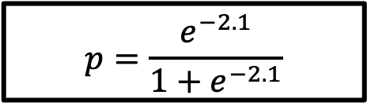
+ Infinity
3
For example, the log(odds) of this data point is -2.1
We substitute -2.1 for the log odds
And we get p = 0.1
2
1
0
-1
$$p=\frac{e^{−2.1}}{1+e^{−2.1}}$$
-2
-3
- Infinity

Slide 20
p = 0.1 gives us the y-coordinates on the S-curved line
1
0
1
2
3
4
5
Weight

Slide 21
And we do the same thing for all data points!
1
0
1
2
3
4
5
Weight

Slide 22
Now we use the observed status to calculate the their likelihood given the shape of the S-curve
Obese
Not Obese
1
2
3
4
5
Weight

Slide 23
We will start by calculating the likelihood of the obese persons given the shape of the S-curve line.
Obese
Not Obese
1
2
3
4
5
Weight

Slide 24
The likelihood that this person is obese given the shape of the S-curve line is the value on the y-axis where the point intersects the S-curve line.
Which is 0.49
Obese
Not Obese
1
2
3
4
5
Weight

Slide 25
The likelihood of this person is obese is 0.9
Obese
Not Obese
1
2
3
4
5
Weight

Slide 26
The likelihood that these people are obese is 0.91, 0.91 and 0.92
Obese
Not Obese
1
2
3
4
5
Weight

Slide 27
Likelihood of data give the S-curve = 0.49 * 0.9 * 0.91 * 0.91 * 0.92…
Obese
The likelihood for all obese persons is just the product of the individual likelihoods
Not Obese
1
2
3
4
5
Weight

Slide 28
Now, let us calculate the likelihoods for the persons who are not obese
Obese
Not Obese
1
2
3
4
5
Weight

Slide 29
For these persons, the likelihood is calculated as:
Likelihood = (1 – probability of the person is obese)
Obese
Not Obese
1
2
3
4
5
Weight

Slide 30
The probability that this person is obese is 0.9
So the probability and likelihood that this person is not obese is
(1 - 0.9)
Obese
Not Obese
1
2
3
4
5
Weight

Slide 31
The probability that this person is obese is 0.3
So the probability and likelihood that this person is not obese is
(1 - 0.3)
Obese
Not Obese
1
2
3
4
5
Weight

Slide 32
The probability that these persons is obese are both 0.1
So the probability and likelihood that these persons are not obese is (1 - 0.1)
Obese
Not Obese
1
2
3
4
5
Weight

Slide 33
Now we can include the individual likelihoods for the persons that are not obese to the equation for the overall likelihood
Obese
Likelihood of data give the S-curve = 0.49 * 0.9 * 0.91 * 0.91 * 0.92 * (1– 0.9) * (1 – 0.3) * (1 – 0.01) * (1 - 0.1)
Not Obese
1
2
3
4
5
Weight

Slide 34
Likelihood of data give the S-curve = 0.49 * 0.9 * 0.91 * 0.91 * 0.92 * (1– 0.9) * (1 – 0.3) * (1 – 0.01) * (1 - 0.1)
Obese
Although it is possible to calculate the likelihood as the product of the individual likelihoods, statisticians prefer to calculate the log of the likelihood
Not Obese
1
2
3
4
5
Weight

Slide 35
log(Likelihood of data give the S-curve) = log(0.49) + log(0.9) + log( 0.91) + log(0.91) + log(0.92) + log(1– 0.9) + log(1 – 0.3) + log(1 – 0.01) + log(1 - 0.01)
Obese
With the log of the likelihood, we add the logs of the individual likelihoods instead of multiplying the individual likelihoods
Not Obese
1
2
3
4
5
Weight

Slide 36
Thus, the log(Likelihood of data give the S-curve) = -3.77
Obese
Not Obese
1
2
3
4
5
Weight

Slide 37
Thus, the log(Likelihood of data give the S-curve) = -3.77
3
2
This also means that the log-likelihood of the original straight line is -3.77
1
0
-1
-2
-3

Slide 38
We can rotate this line and calculate the log likelihood again until we get a line that maximize the likelihood and that’s the chosen one to have the best fit.
3
2
1
0
-1
-2
-3

Slide 39
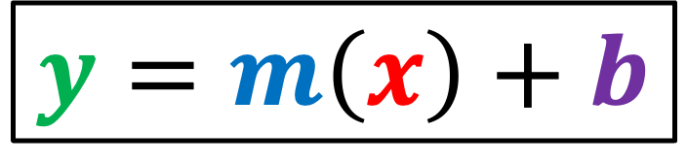
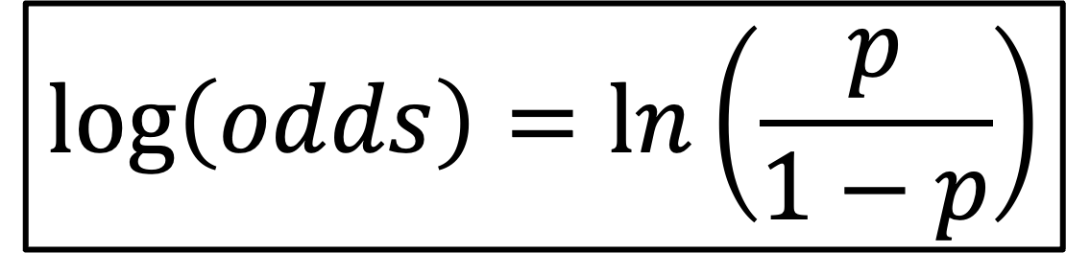
Logistic/Sigmoid Function
$$\log\left(odds\right)=\ln\left(\frac{p}{1−p}\right)$$
$$y=m\left(x\right)+b$$

Slide 40
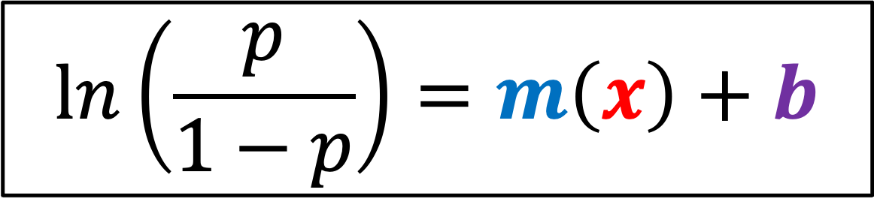
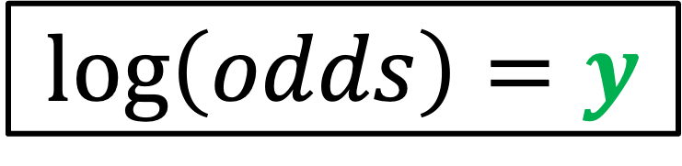
Logistic/Sigmoid Function
$$\log\left(odds\right)=y$$
$$\ln\left(\frac{p}{1−p}\right)=m\left(x\right)+b$$

Slide 41
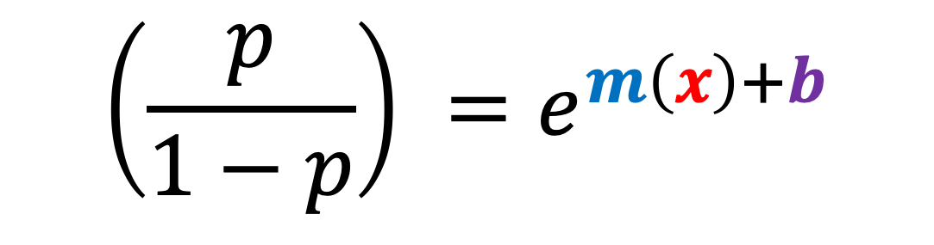
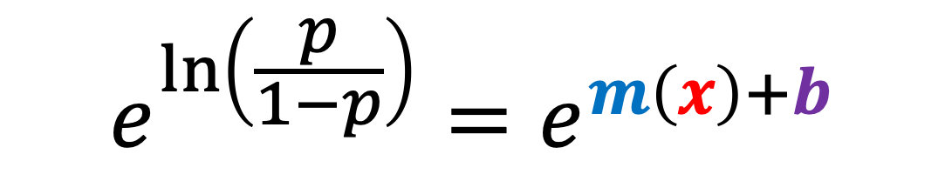
Logistic/Sigmoid Function
$$e^{\ln\left(\frac{p}{1−p}\right)}=e^{m\left(x\right)+b}$$
$$\left(\frac{p}{1−p}\right) =e^{m\left(x\right)+b}$$

Slide 42



Logistic/Sigmoid Function
$$\left(\frac{p}{1−p}\right) =y$$
$$p=y(1−p)$$
$$p=y−y(p)$$

Slide 43


Logistic/Sigmoid Function
$$p=y−y(p)$$
$$p+y(p)=y$$
$$p(1+y)=y$$

Slide 44
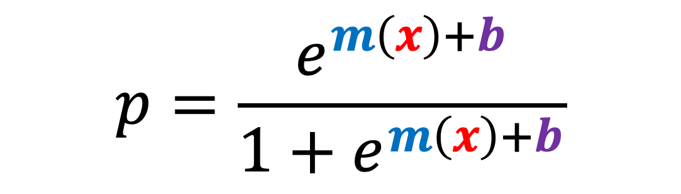

Logistic/Sigmoid Function
$$p(1+y)=y$$
$$p=\frac{y}{1+y}$$
$$p=\frac{e^{m\left(x\right)+b}}{1+e^{m\left(x\right)+b}}$$

Slide 45
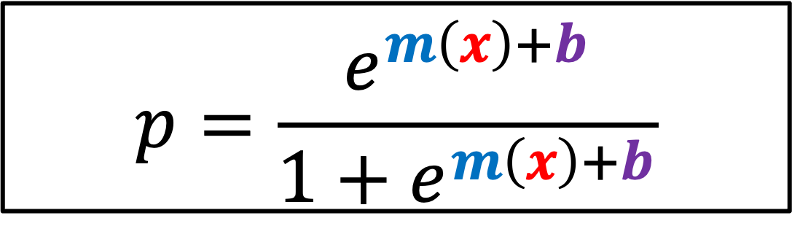
Logistic/Sigmoid Function
$$p=\frac{e^{m\left(x\right)+b}}{1+e^{m\left(x\right)+b}}$$

Slide 46
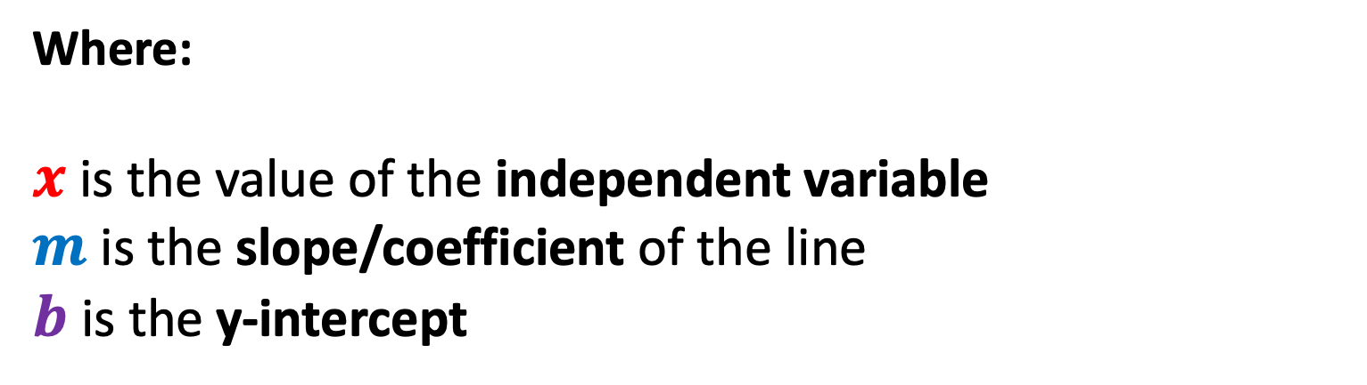
Logistic/Sigmoid Function
$$p=\frac{e^{m\left(x\right)+b}}{1+e^{m\left(x\right)+b}}$$
Where:
$x$ is the value of the independent variable
$m$ is the slope/coefficient of the line
$b$ is the y-intercept

Slide 47
Math Behind Logistic Regression
Maximum Likelihood

Slide 48
Maximum Likelihood Estimation
Maximum likelihood estimation is a method that determines values for the parameters of a model.
The parameter values are found such that they maximize the likelihood that the process described by the model produced the data that were actually observed.
In Logistic Regression, MLE is used as the Cost Function.

Slide 49
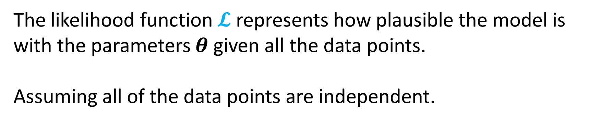
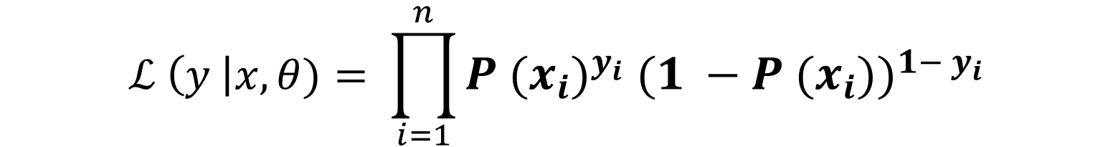
Maximum Likelihood
$ℒ \left(y \right|x, θ)= ℙ$ $\left(y_{1} \right|x_{1} β) ∗ℙ \left(y_{2} \right|x_{2} β)…∗ ℙ$ $\left(y_{n} \right|x_{n} β)$
$$ℒ \left(y \right|x,θ)= \prod_{i=1}^{n}{P {{(x}_{i})}^{y_{i}} {(1 −P (x_{i}))}^{1− y_{i}}}$$
The likelihood function $𝓛$ represents how plausible the model is with the parameters $θ$ given all the data points.
Assuming all of the data points are independent.

Slide 50
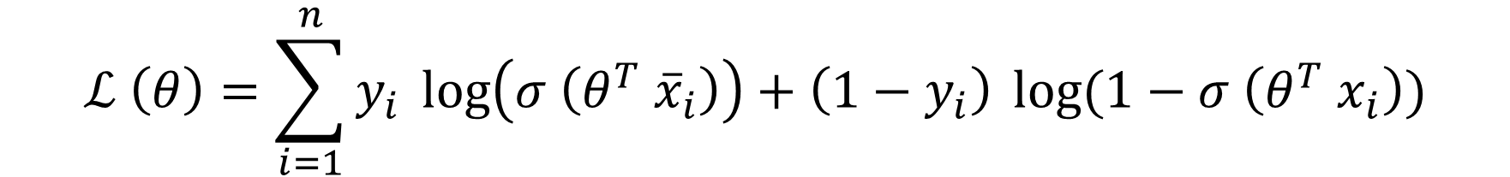

Log Likelihood
$$ℒ (θ)= \prod_{i=1}^{n}{P {{(x}_{i})}^{y_{i}} {(1 −P (x_{i}))}^{1− y_{i}}}$$
$$ℒ \left(θ\right)=\sum_{i=1}^{n}{y_{i}} \log\left(σ \left(θ^{T} {\overline{x}}_{i}\right)\right)+\left(1−y_{i}\right) \log{(1−σ \left(θ^{T} x_{i}\right))}$$

Slide 51
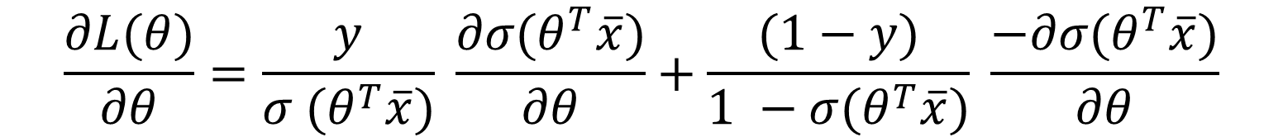
Gradient Ascent
$$\frac{∂L(θ)}{∂θ}=\frac{y}{σ (θ^{T}\overline{x})} \frac{∂σ(θ^{T}\overline{x})}{∂θ}+\frac{(1−y)}{1 −σ(θ^{T}\overline{x})} \frac{−∂σ(θ^{T}\overline{x})}{∂θ}$$
$$\frac{∂L(θ)}{∂θ}=\left(y−p \left(x\right)\right) \overline{x}$$
$$\frac{∂L(θ)}{∂θ}=\left(y−σ (θ^{T}\overline{x})\right) \overline{x}$$
Get the derivative of the log likelihood with respect to theta $θ$

Slide 52
Gradient Ascent
$$θ^{+} = θ^{−}+ α (\frac{∂L(θ)}{∂θ})$$
$$θ^{+} = θ^{−}+ α\left(y−p \left(x\right)\right) \overline{x}$$
Equation to update the logistic regression model parameters $θ$

Slide 53
References
https://www.youtube.com/watch?v=ARfXDSkQf1Y
https://www.youtube.com/watch?v=yIYKR4sgzI8&list=PLblh5JKOoLUKxzEP5HA2d-Li7IJkHfXSe&index=1
https://lottotips888.blogspot.com/p/grand-lotto-655.html

